Slide 1
Oct 27

Slide 2
Changes
Removed jets within dR = 1 of fat jets ( I do find many jets that have almost the same kinematics of some fat jets)
Q: I removed jets within dr = 1 with respect to any fat jet in that event. Should this be changed to w.r.t. the highest-pt fat jet?
Cut flow chart
Weighted training (also, no reg vs reg performed similarly)
Efficiency curve

Slide 3
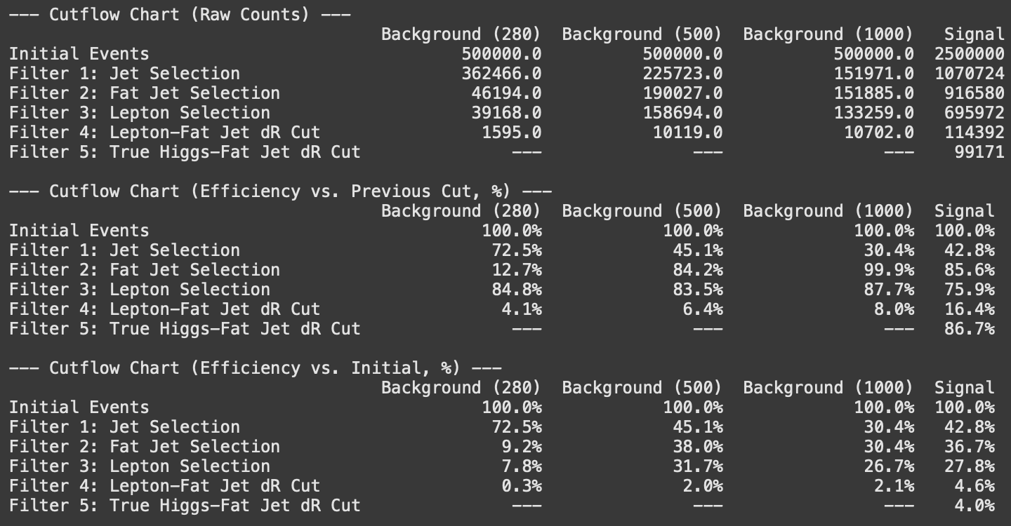
Cut flow chart

Slide 4
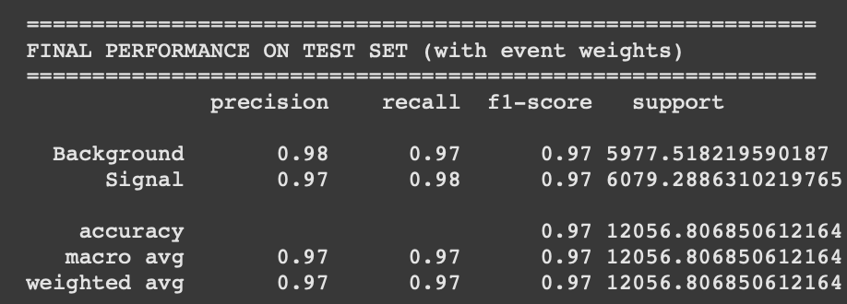
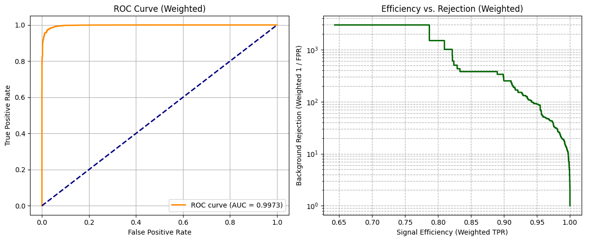
Weighted training results

Slide 5
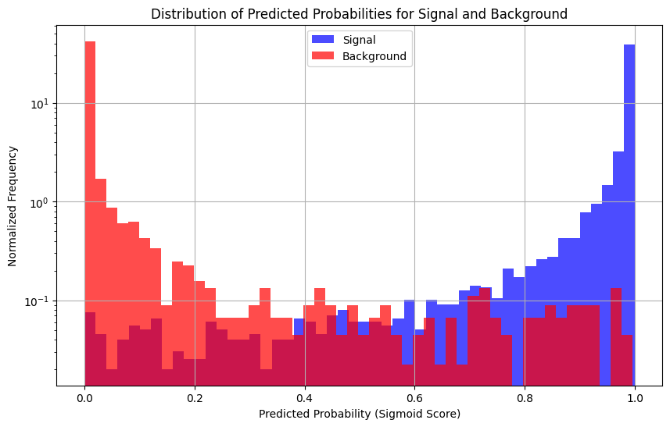
Sigmoid score histogram

Slide 6
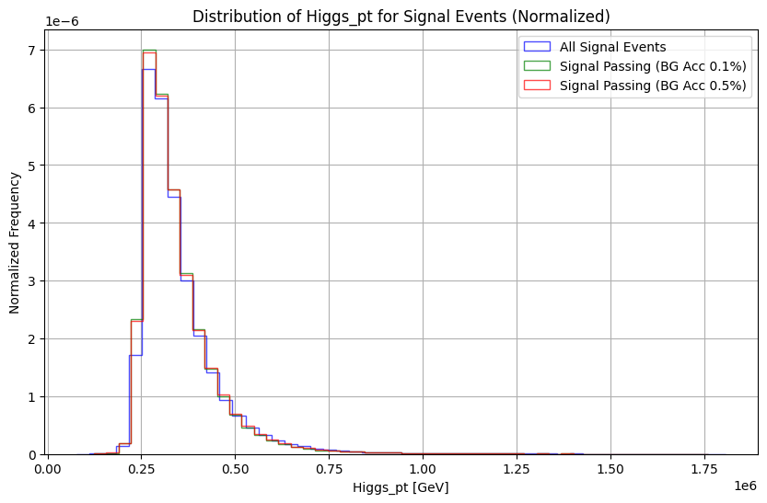
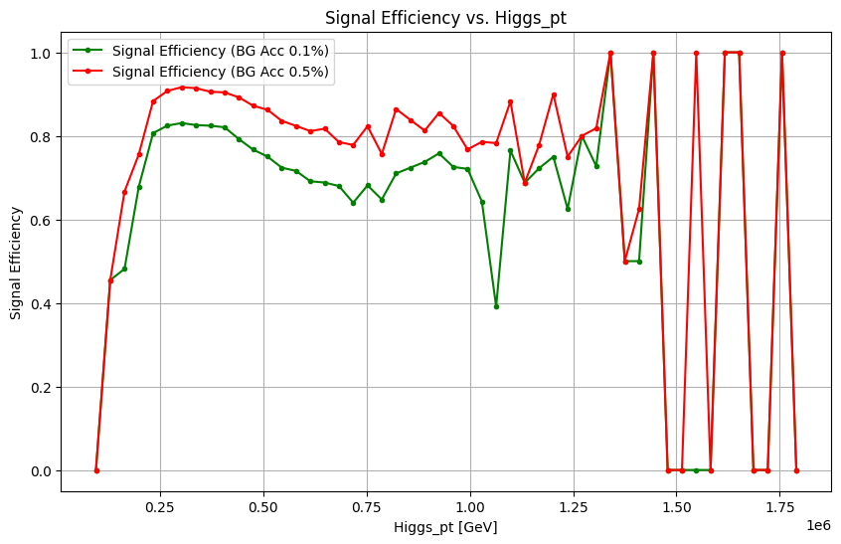
Efficiency curve
(the unit should be TeV (ignore 1e6))

